Slide 1



Tyres sales and inventory website
PROJECT MEMBERS
KAMALESH M - 23ITR026
KARTHIK R - 23ITR080
(19ITR014)
PROJECT GUIDE
Dr.T.ABIRAMI
Associate Professor/Department of IT
Kongu Engineering College

Slide 2
KEC-IT
COMPANY DETAILS
Company Name :
ARM Steel Agency
Owner :
Jegadeesan P
Address :
146/2, Palani Main Road, Madathukulam,
Tiruppur dt - 642113
Contact :
Phone no: +91 9865754505, +91 9443810807
Email: www.jagathisanp@gmail.com
2

Slide 3
KEC-IT
OBJECTIVE
To develop a secure and responsive mobile app that allows users to browse steel products, place orders, make online payments, manage inventory in real time, and access features based on their roles.
3

Slide 4
KEC-IT
PURPOSE OF THE PROJECT
Problem Statement
To develop a digital platform for customers to browse/purchase steel products online, relying on manual orders and in-person sales.
Solution
Develop a cross-platform e-commerce application to:
Digitize sales and inventory management.
Enhance customer reach and provide 24/7 accessibility.
Streamline payments using secure Razorpay integration.
4

Slide 5
KEC-IT
REQUIREMENTS OF THE PROJECT
HARDWARE REQUIREMENTS
Processor : Intel Pentium
Processor Speed : 250MHz to 667MHz
RAM : 8GB RAM
Hard Disk : 512GB
Keyboard : Standard 104 enhanced
Mouse : Local PS/2
SOFTWARE REQUIREMENTS
Platform : Visual Studio Code
Server-side Script : JavaScript
Cloud-based platform : MongoDB
Framework : React-Native
5

Slide 6
KEC-IT
Technology Stack
Frontend: React Native, JavaScript
Backend: MongoDB
Payment Gateway: Razorpay API
Tools: Expo CLI, Visual Studio Code, Git, Postman (for API testing)
6

Slide 7
KEC-IT
LIST OF MODULES
Admin
Product Management
Order Management
User
User Authentication
Product Management
Wishlist Management
Payment Management
Cart Management
7

Slide 8
KEC-IT
MODULE DESCRIPTION
USER MODULE
1. User Authentication • Provides secure login and registration for users. • Supports role identification for both customers and admins.
2. Product Management • Allows admin to add, edit, and delete steel products. • Includes fields like category, description, price, and stock quantity.
3. Order Management • Enables customers to browse products and add items to the cart. • Allows order placement and real-time order tracking.
4. Payment Integration • Integrates Razorpay API for secure and reliable payments. • Captures and tracks transaction details.
8

Slide 9
KEC-IT
MODULE DESCRIPTION
ADMIN MODULE
1. Admin Dashboard
Displays total orders, payment statistics, and inventory data.
Offers a mobile-friendly interface for easy monitoring.
2. Product Management
Allows admin to add, edit, and delete steel products.
Includes fields like category, description, price, and stock quantity.
9

Slide 10
SignUp
USECASE DIAGRAM
Login
Search Products
New user
Add Products
Add to cart
Delete Products
Update Products
Checkout
Admin
Manage Accounts
Payment
Delete accounts
Existing User
Logout

Slide 11
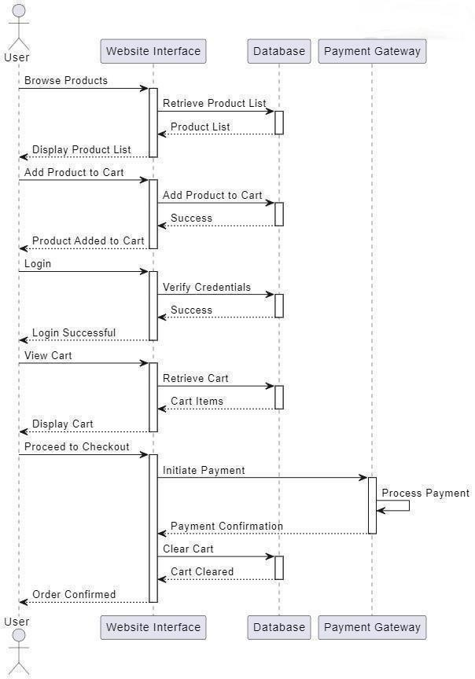
SEQUENCE DIAGRAM

Slide 12
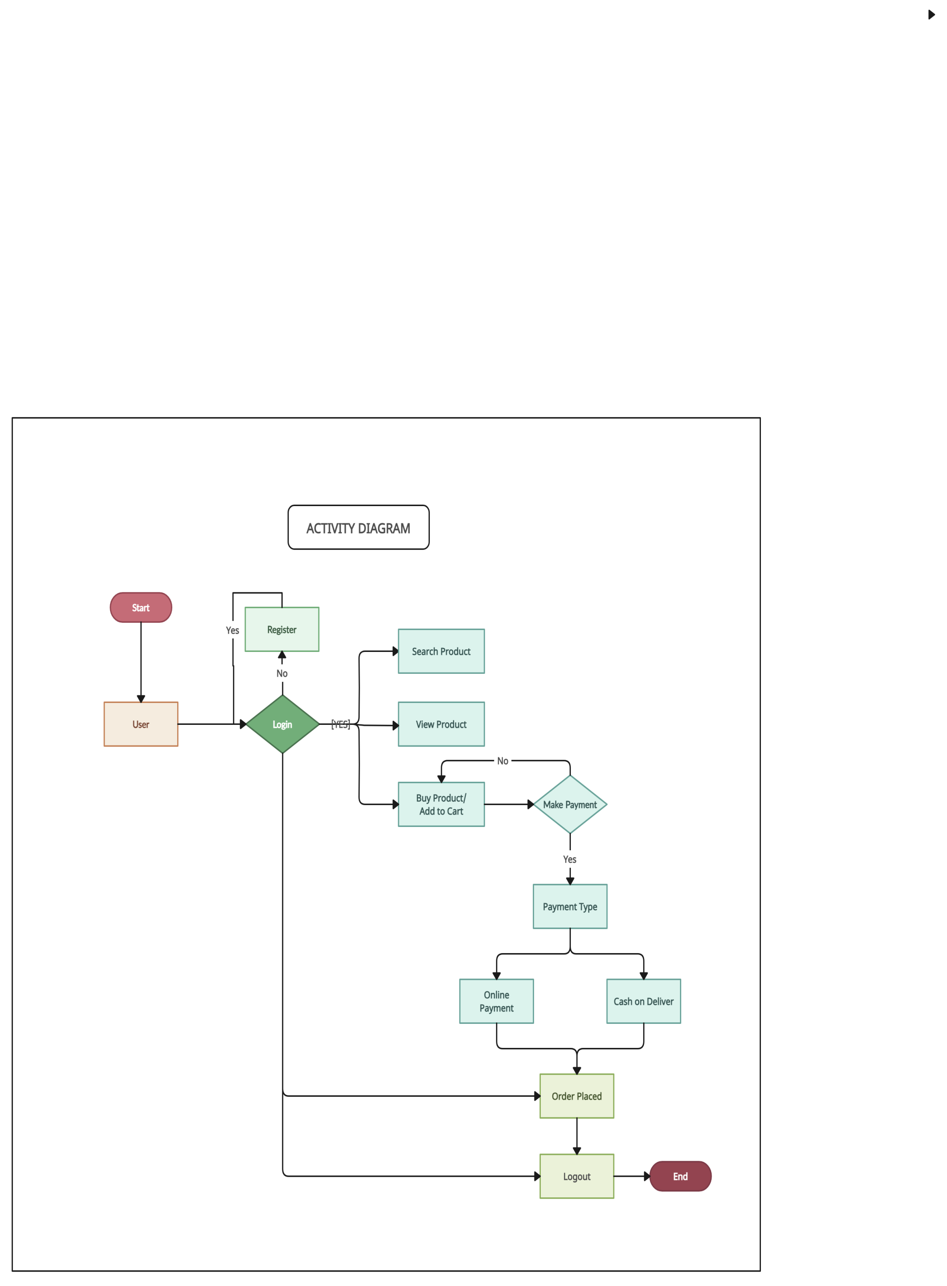
ACTIVITY DIAGRAM

Slide 13
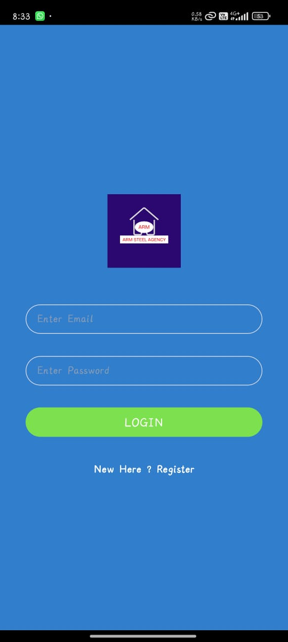
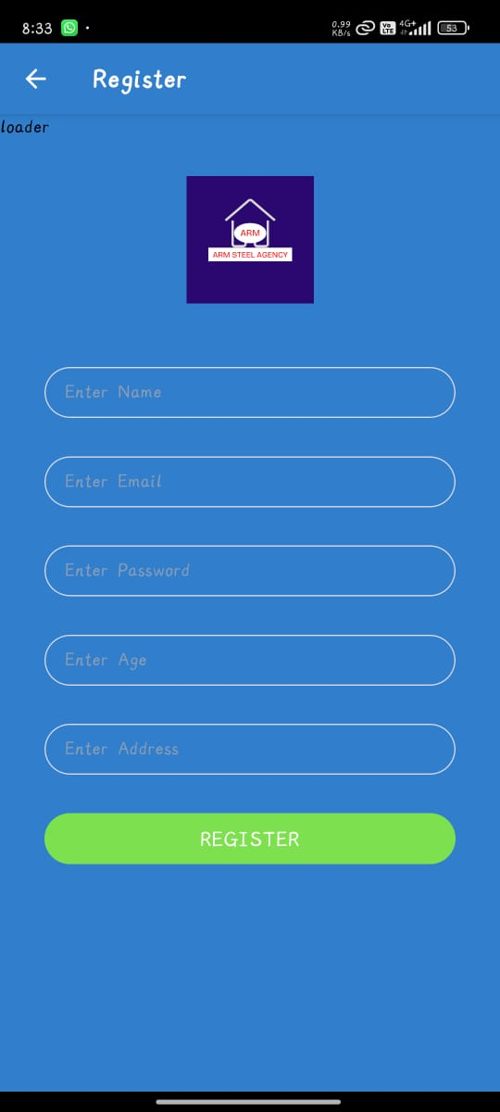
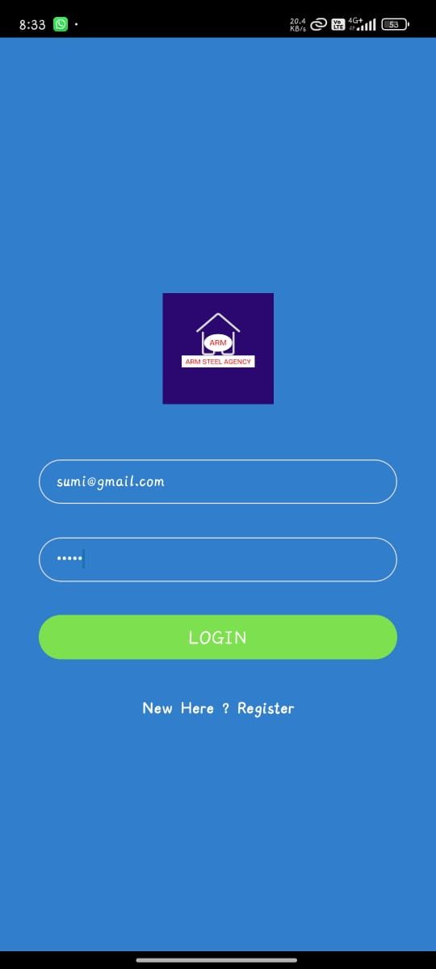
OUTPUT SCREENSHOTS
Login & Signup page

Slide 14
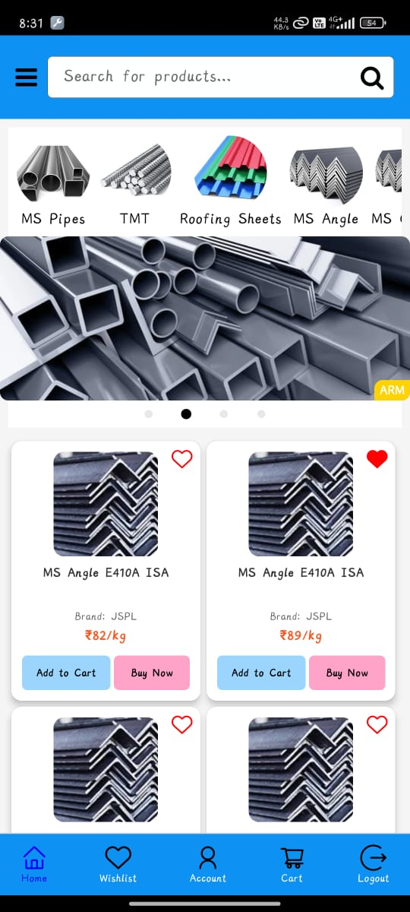
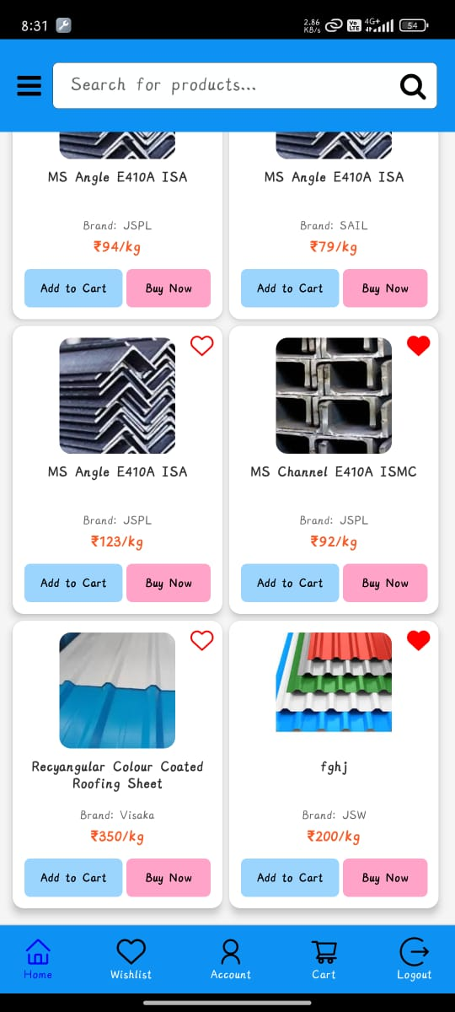
Home Page – Best Selling Products

Slide 15
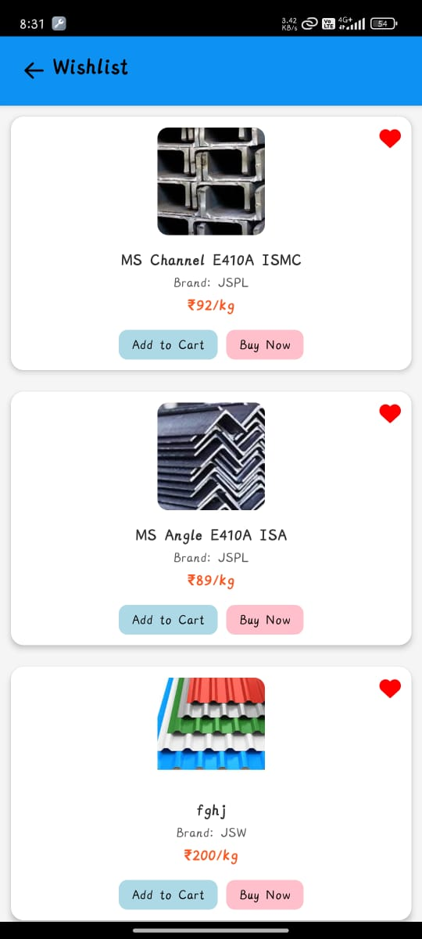
Wishlist page

Slide 16
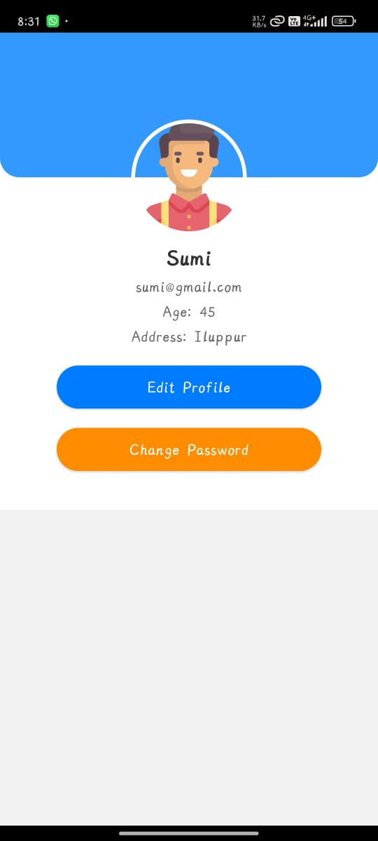
Profile page

Slide 17
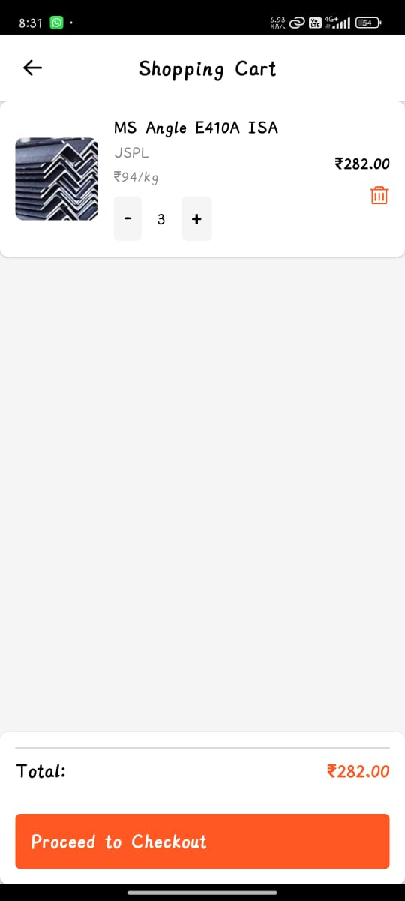
Cart Page

Slide 18
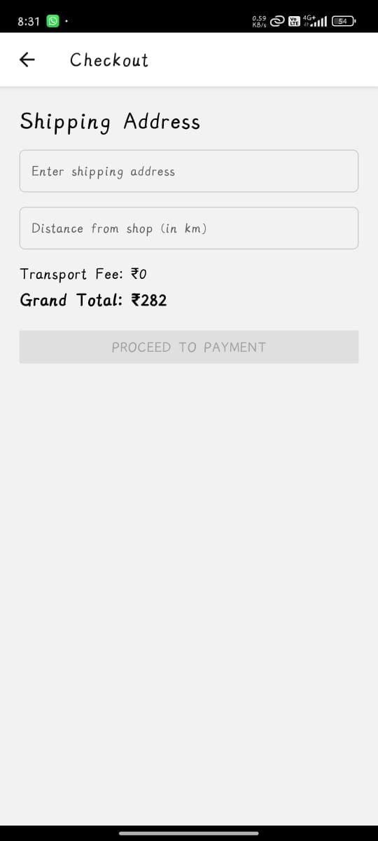
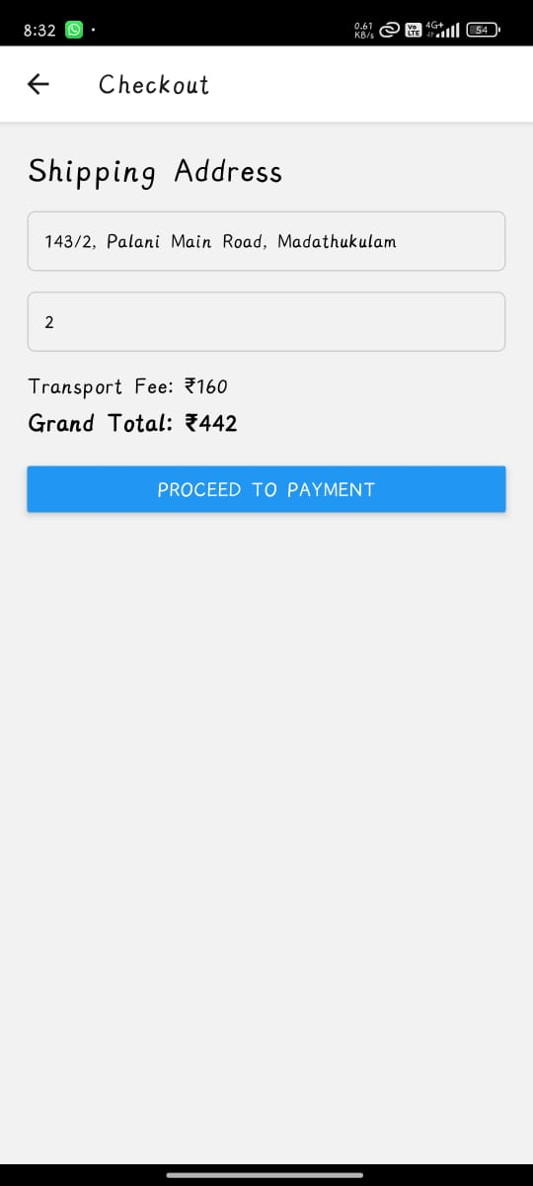
Checkout Page

Slide 19
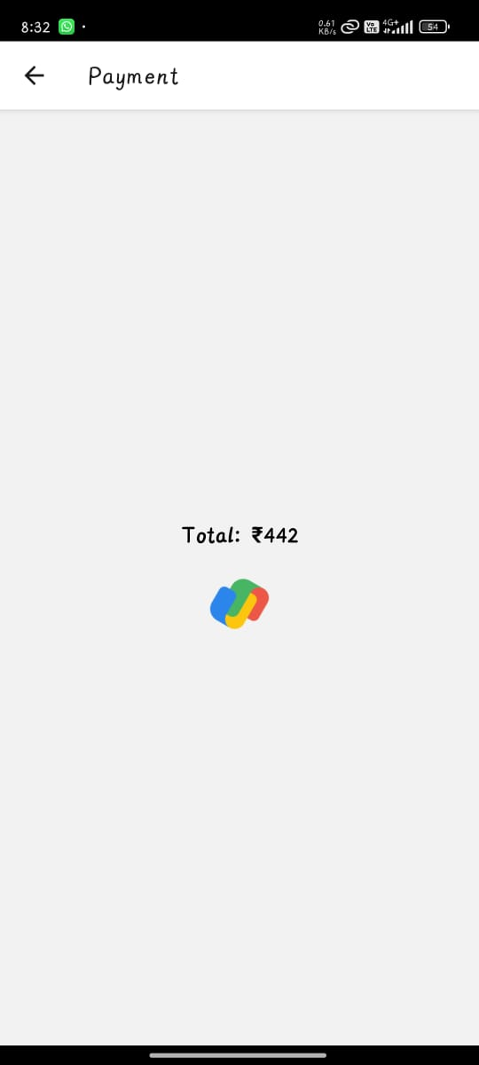
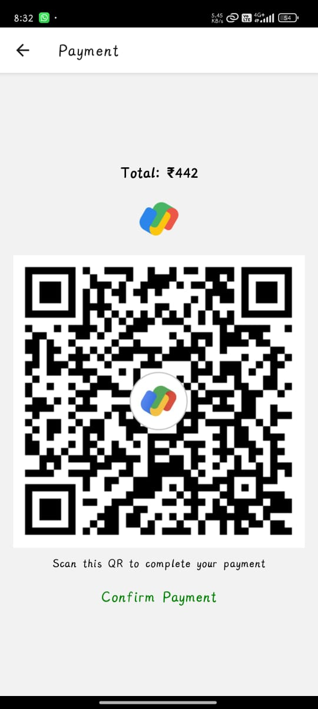
Payment page

Slide 20
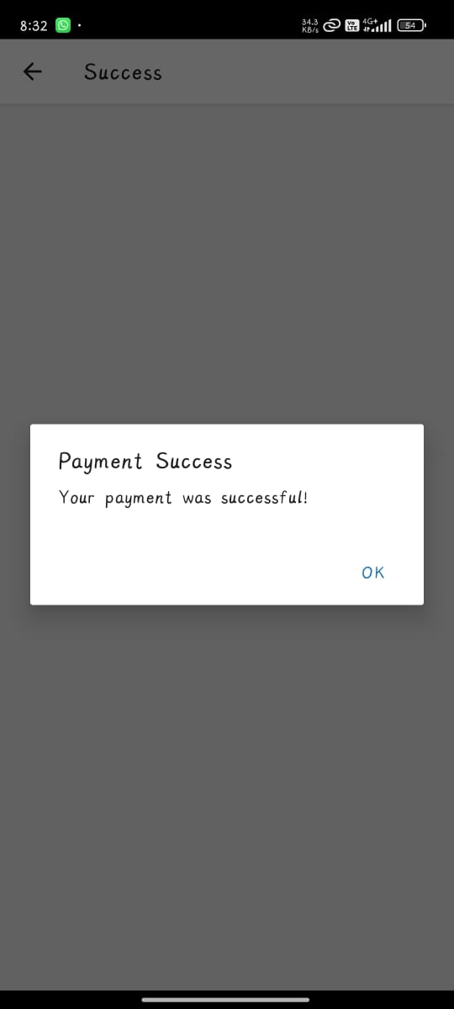
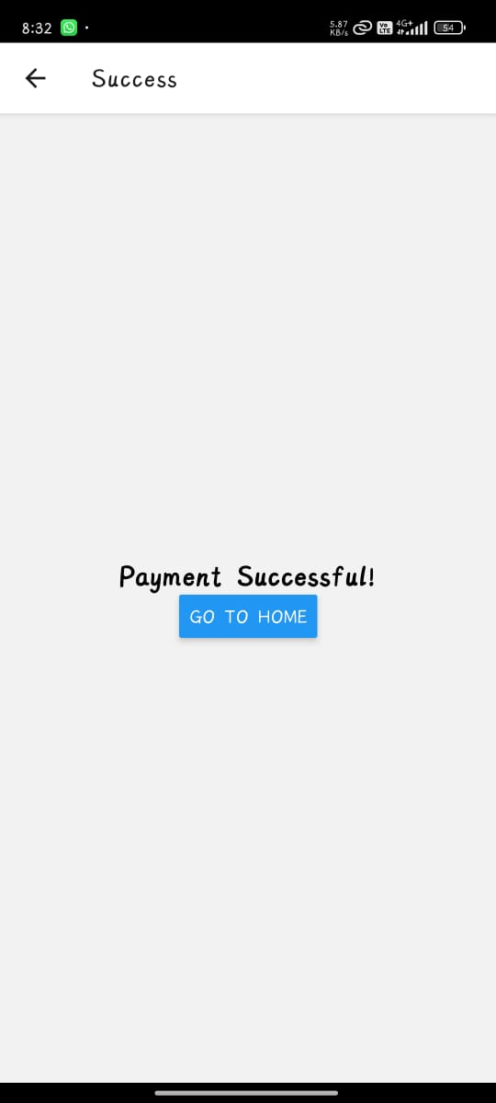
Payment successful page

Slide 21
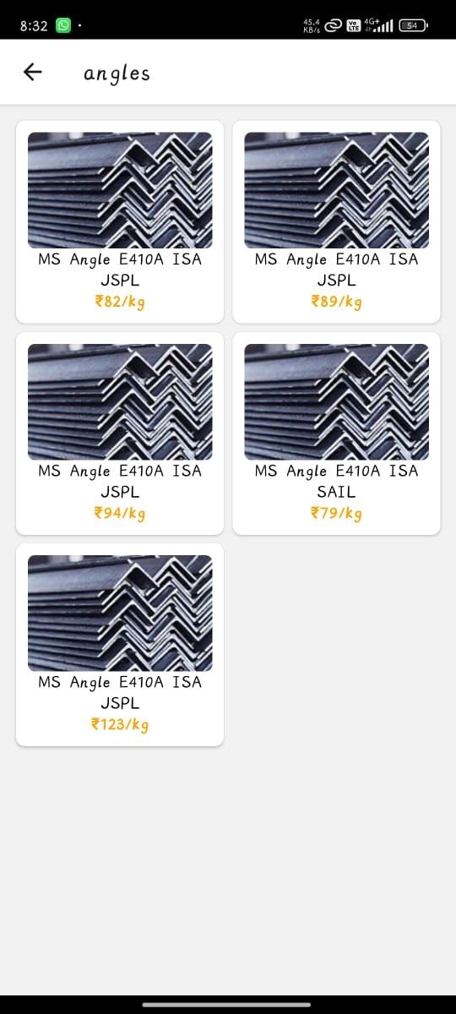
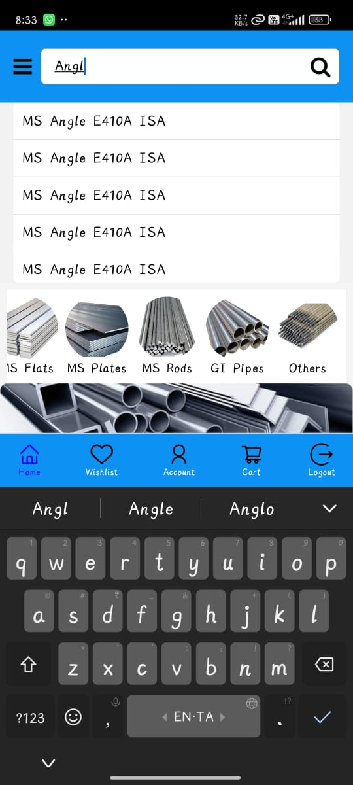
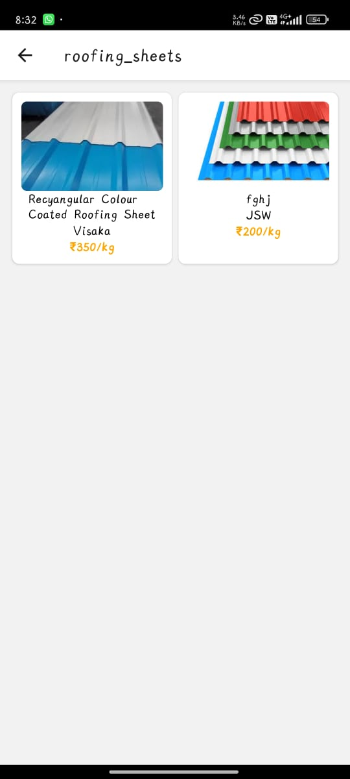
Steels- based on category

Slide 22
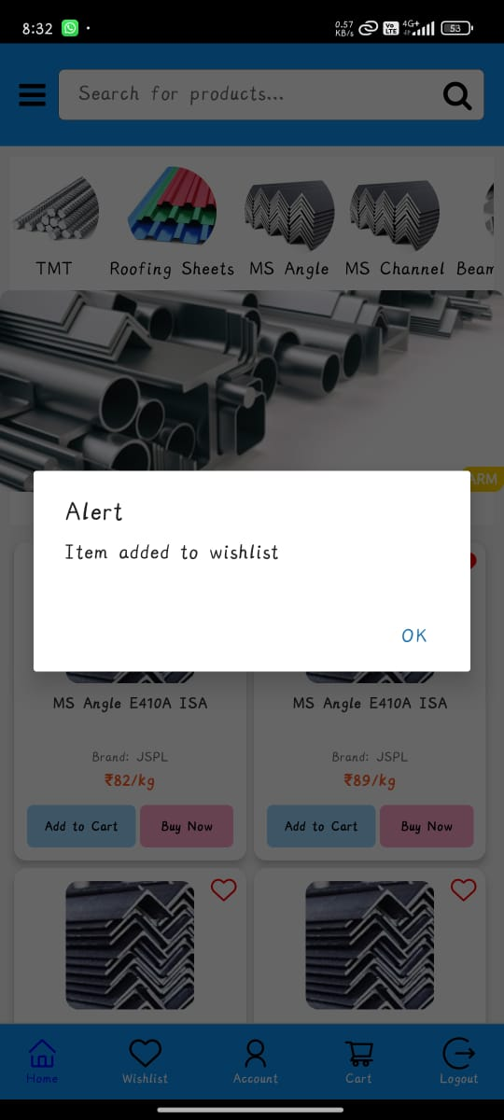
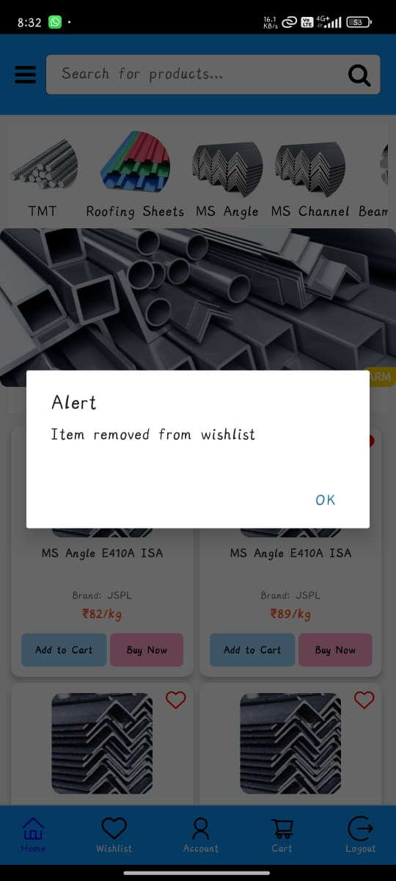
Wishlist added items page

Slide 23
CONCLUSION
The ARM Steel Agency e-Commerce App offers a seamless, secure, and scalable platform for steel product sales.
Automates key operations:
Order management
Payment processing
Inventory tracking
Enhances customer satisfaction through mobile accessibility
Boosts business productivity by digitizing core processes

Slide 24
REFERENCES
Online Resources:
https://legacy.reactjs.org/docs/getting-started.html
https://www.youtube.com/watch?v=kmU7uX3ZHJc
https://nodejs.org/en/docs/
https://firebase.google.com/docs/build

Slide 25
KEC-IT
THANK YOU
25

